Slide 1
Lex Automagica: The Dawn of The Clockwork Society?
Blockchain & Legal innovation I - Lecture 1

Slide 2
What Makes Us Human?

Slide 3
1 – Our Capacity For the Inter-Subjective Makes Us Human
Examples of The Inter-subjective
Gods
Laws
Money
Writing
Culture
Stories
In “Homo Deus: A Brief History of Tomorrow”, Yuval Noah Harari outlines how humans are distinguished from other animals by our capacity to create the inter-subjective reality.
The inter-subjective is the world that is real only because we, together, agree it is real.

Slide 4
How Do We Prosper?

Slide 5
2 – Inter-subjective Allows For Social Scaling
Social Scaling Technology
Culture & Laws (& Gods)
Money >> Coins
Numbers & Ledgers
Stories
Book of Dooms (Legal Code)
The Domesday Book (Census)
Excel & Databases
The Internet
The Inter-subjective creates the capacity for social scaling – the ability for humans to co-operate outside kin and clan.
In his essay “Money, Blockchains and Social Scalability”, Nick Szabo outlines how social scaling is what facilitates wealth creation. Advancements – like money - that improve our capacity for information sharing and trust minimization increase human wealth.

Slide 6
Social Scaling
SOCIAL SCALING
is the ability of an institution –- a relationship or shared endeavour, in which multiple people repeatedly participate, and featuring customs, rules, or other features which constrain or motivate participants’ behaviours -- to overcome shortcomings in human minds and in the motivating or constraining aspects of said institution that limit who or how many can successfully participate.

Slide 7
Benefits of Social Scaling
We use social institutions to overcome cognitive limitations in matchmaking (finding mutually beneficial relationships) and trust-minimisation.
The Trust must be institutionalised.
The Institution must be able to scale.
Traditional institutions are bursting because the trust layer – officials, police, accountants, lawyers – and the matchmaking function – middlemen and gatekeepers – are struggling to keep pace with the speed and ease of information sharing.

Slide 8
What Is A Good Example?

Slide 9
Money: The Ultimate Good
Money Is Not The Root Of All Evil
It Is The Root Of All Human Progress

Slide 10
The Benefits of Money
Money Allows Social Scaling
Money Allows Trades Outside Trust Of Kin And Clan
Money Allows Trade Independent Of Time
Money Provides Matching And Trust

Slide 11
Why Have We Stopped Prospering?

Slide 12
3 – Current Social Scaling Tech Has Reached Its Limits
Symptoms of Breakdown in Social Scaling
Rich & Powerful Gatekeepers
Bankers
Lawyers
Accountants
Facebook
Google
Increasing conflict
Decreasing trust in institutions
Online Tribes
The internet was our latest breakthrough in social scaling. But it scaled information sharing, not trust.
The trust layer is provided by increasingly powerful & wealthy gatekeepers & middlemen.
But trusted third parties are security holes and lawyer magnets. The result is a complex and costly layer of bureaucrats, accountants, lawyers, and police.

Slide 13
How Do We Keep Scaling?

Slide 14
4 – Blockchain Is The Next Social Scaling Innovation
Key Benefit
Blockchains scale trust by confirming something is true without a middleman or gatekeeper
Key Features
Distributed – any one can know
Decentralised – any can use
Censorship-proof – everyone can trust
Tokenized – everything can be tracked & valued
A block-chain computer, is shared across many computers each checking each other's work, and reliably and securely executing our instructions.
Bitcoin is a proof of concept for blockchain technology applied to money.
Ethereum is an example of blockchain technology as a world computer

Slide 15
Can We Really Scale Without MIddlemen?

Slide 16
Enter - Bitcoin
Bitcoin Is Trustworthy Money Without The Police Or Middlemen

Slide 17
How Bitcoin Works
It Does This Using Blockchain, A Technology That Scales Markets –Ownership Prices And Money - And Social Interaction By Automating Trust

Slide 18
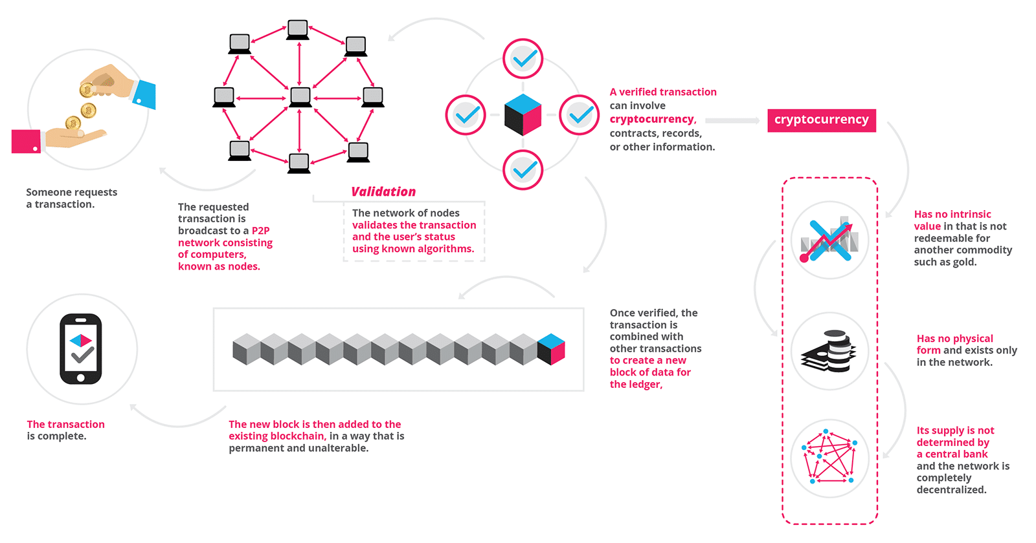
Blockchain

Slide 19
Essential Characteristics
Distributed Ledger – No Gatekeepers
Persistent – Every Txn Recorded (Protects Against Fraud)
Cannot Be Edited – Trust The Information Is True
Digital Tokens – Unforgeable (A Bitcoin Is A Bitcoin)

Slide 20
Bitcoin As Money
Unforgeable
Mathematically Limited Supply
Difficult To Create
Certainty Of Ownership
Ease Of Transfer

Slide 21
How Bitcoin is Created
Bitcoin Is ‘Mined’
Computers Solve Cryptographic Puzzles And Are Rewarded For Their Efforts In Bitcoins – Digital Assets On The Chain

Slide 22
Just the Beginning?
Bitcoin Is The First Proof Of Concept Of Blockchain Technology
There Are Now Over 1500 Blockchain/Digital Asset Projects

Slide 23
Really? What About Things Other Than Money?

Slide 24
5 – Blockchain, Smart Contracts & AI = Clockwork Society
Technology of A Clockwork Society
Blockchain – distributed ledgers of “truth”
Digital Tokens – instant micro-payments
Smart Contracts – automated conditional execution
Artificial Intelligence – automated conditional determinations
Off-Chain Trust Layer – a leaner, cheaper layer of humans dealing with things that can’t be dealt with “on-chain”.
Smart Contracts are small apps that automate transactions on a blockchain
AI is learning machines applying algorithms to large data sets to replicate/approximate decisions of similarly placed humans
The Clockwork Society is the application of blockchain, smart contracts and AI to create a society that works through code and market dynamics, not gatekeepers and middlemen.

Slide 25
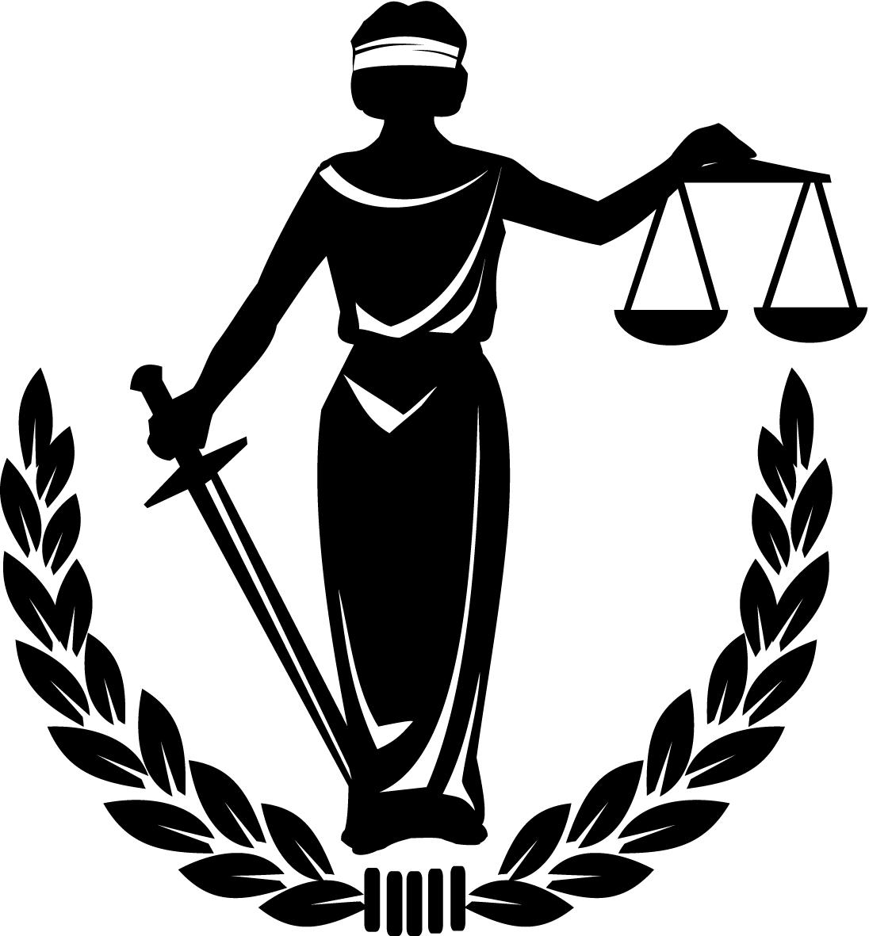
Can We Scale Justice?
Lex Automagica
Legal Processes
Smart Contracts
AI/ML
AR/VR
Tokens
Blockchain

Slide 26
The Law Only Deals With 4 Things
People
Things
Relationships
Disputes
Individuals
Corporations
Money
Property
Shares
Data
Definitions
Rights
Consent
ADR
Tribunals
Courts
Obligations
AI?
Code

Slide 27
Blockchain is Trying To Automate Law
People
Things
Relationships
Disputes
Sovrin
SelfKey
Bitcoin
STOs
Propy
ChainLink
OpenLaw
DeFi
Kleros
OpenCourt
JUR
Supply Chains
Civic

Slide 28
6 – The Possibility of Automating Laws
The Off-Chain/On-Chain Membrane
Problem is moving from off chain to on-chain, analogue to digital
Bitcoin works because bitcoins are created on-chain.
Generally need to trust a third party – introduces counter-party risk (e.g. governments putting land titles on blockchains)
Trusted third parties are security holes and lawyer magnets
Smart Contracts and AI may partly solve this problem
Blockchain can “prove” existence and ownership
Smart Contracts and AI can regulate relationship
Off chain mechanisms can handle disputes and exceptions;
The main problem is moving from the real world to the blockchain.

Slide 29
The Vision: Integrated Automation
People
Things
Relationships
Disputes
Self-KYC
Digital Companies
Currencies
Securities
DApps
Decentralized Dispute Resolution Protocols
Smart Contracts
Self Governing Machines
Property
Privileges
Data
Use-Specific Platforms
Off-Ramps to Traditional Forums

Slide 30
7 – New Emphasis For Wealth Creation
In a Clockwork Society, wealth will increasingly accrue to those who make and create, not to those who approve and facilitate.
In our current society, gatekeepers and middlemen have become massively wealthy and powerful.
They provide the trust that underpins our current social scaling technology.
They lose their position of power and preference if we scale trust minimization so that people can do more work peer-to-peer.

Slide 31
8 – New Markets to Buy & Sell New Goods
In a Clockwork Society, tokenization will allow for anything of value to be tracked and traded, giving rise to new markets and new sources of wealth (and taxation)
The Lydian Kings like Croesus became massively wealthy when they invented coins and tokenized gold.
Blockchain allows for tokenization on a new scale.
Tokenization allows for micro-payments and micro-payments allows for micro-markets.
Micro-markets allows buying and selling of new types of things.

Slide 32
Innovation Opportunities
Anywhere There Are Gatekeepers Or Middlemen
Anywhere The Trust Layer Has Become Too Costly To Permit Social Scalability
Any Increase In The Capacity For Strangers To Make Valuable Trades Or Matches Without Trust.

Slide 33
Examples Beyond Bitcoin
Trading Excess Resources
Sustainable Energy
Predictions
Privacy
Copyright
Predictions

Slide 34
9 – Politics is The New Bull Market
In the future, we can expect intense political fights over the ownership, control and wealth (re)distribution of the combination of blockchain, smart contract and AI technology.
Calls to regulate tech companies as utilities and the concept of Universal Basic Income are examples of the beginning of this fight.
As any member of a rowing club knows, politics is the fight over control of the common wealth or resources.
In a Clockwork Society, enormous wealth/power is provided by the Blockchain/SmartContracts/AI. This generates politics.
Bitcoin proves this.
AI is particularly susceptible because the owner of the biggest/best database wins.

Slide 35
10 – New Philosophy of Government
In a Clockwork Society, Government should only do those things that can’t feasibly be done “on-chain” through code and market dynamics.
Government should not do those things best handled by the “fiduciary code” of a Blockchain – where trust is too important to be left to a trusted third party.
Government is the ultimate gatekeeper.
Blockchain obsoletes gatekeepers.
The Blockchain space has projects dealing with:
Money;
Identity;
Privacy;
Ownership;
Voting
So, why government?

Slide 36
11 – The Next Long War Has Already Begun
Bitcoin was founded by anti-government libertarians. They dream of a peer-to-peer future.
It is not clear that parliamentary democracies are best suited to a clockwork society.
What form of government will out-complete the others in the next long war?
In “The Shield of Achilles” Phillip Bobbitt outlines how the interplay of technology and warfare leads to new conceptions of government.
Parliamentary democracies won ”the Long War” against Communism, Fascism over the shape of the Nation State.
Blockchain, Smart Contracts and AI as a technology suite will fuel a new “long war” as the Nation State stumbles. What will emerge? The Market State?

Slide 37
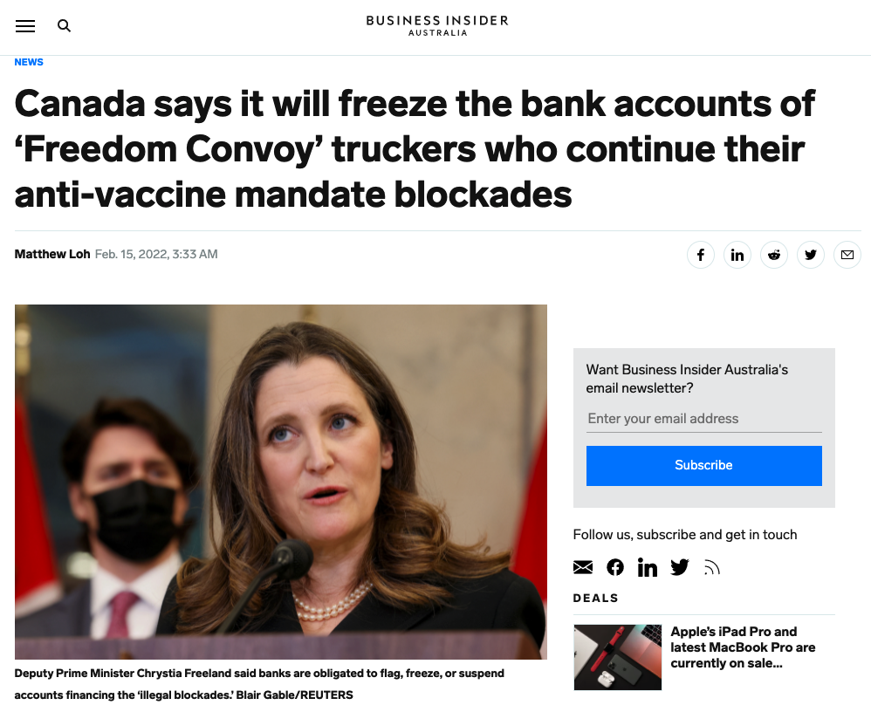

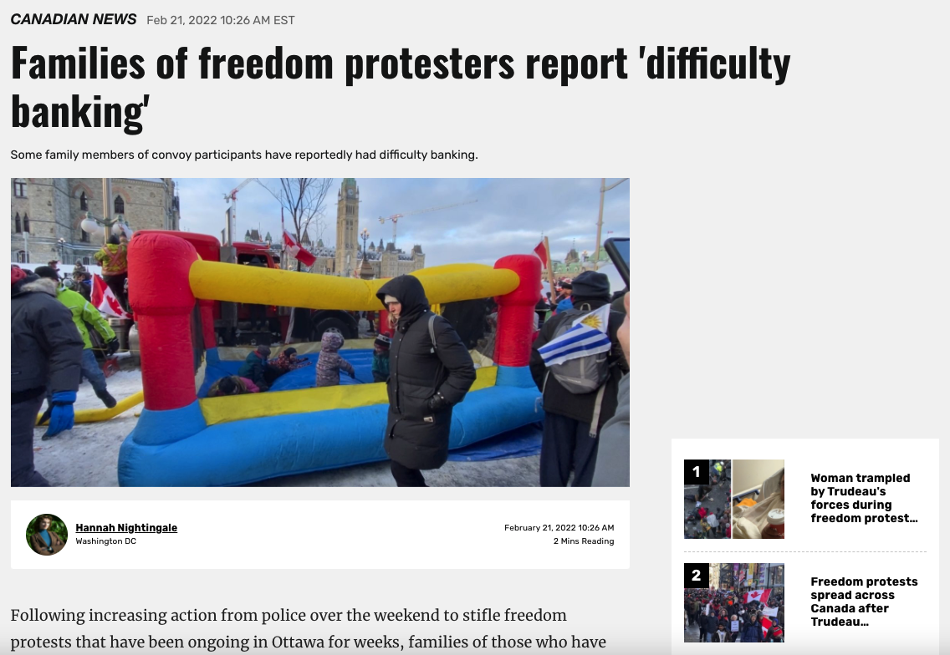
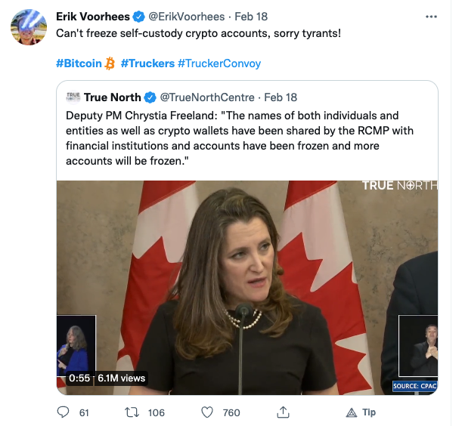

Slide 38
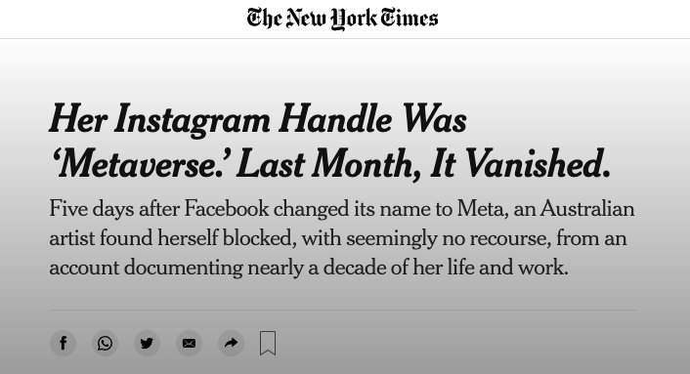
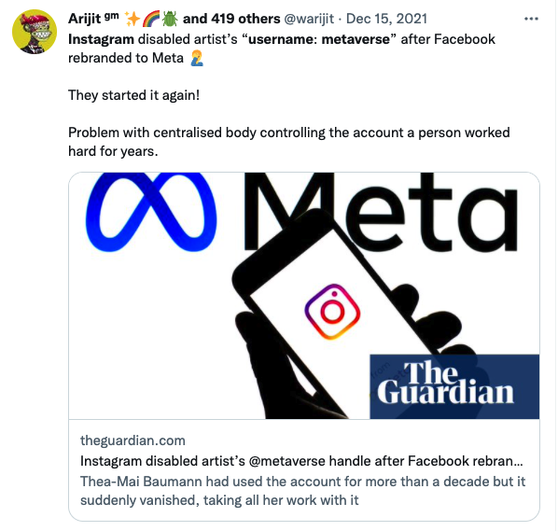

Slide 39

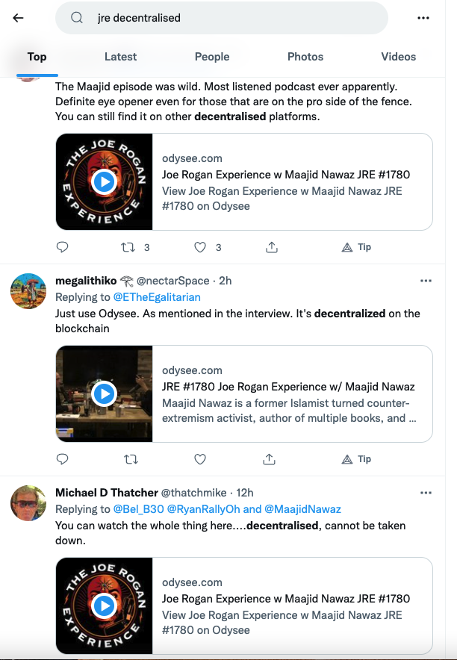
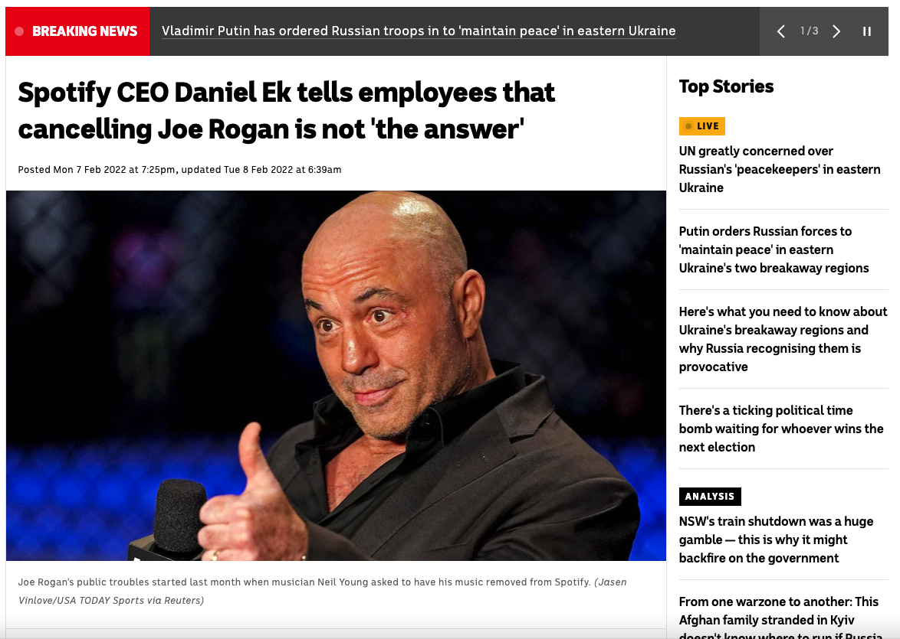

Slide 40
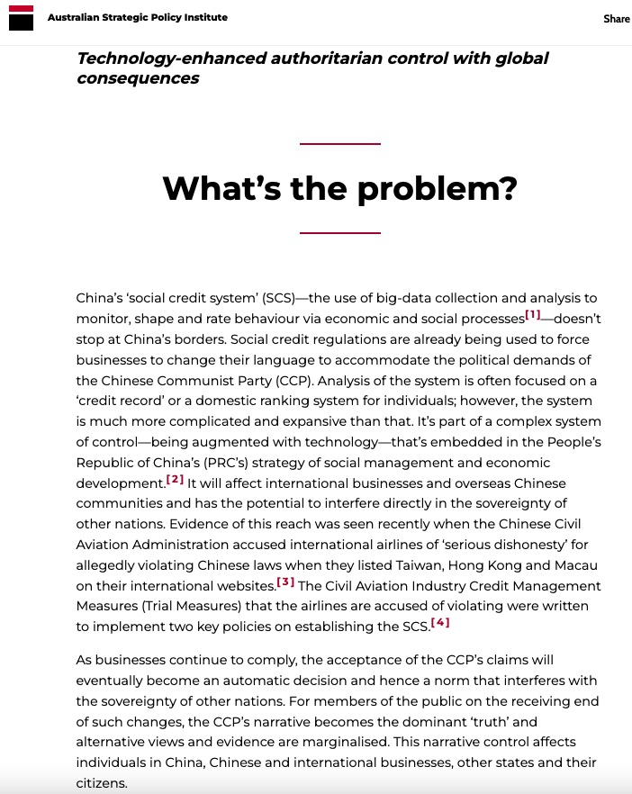
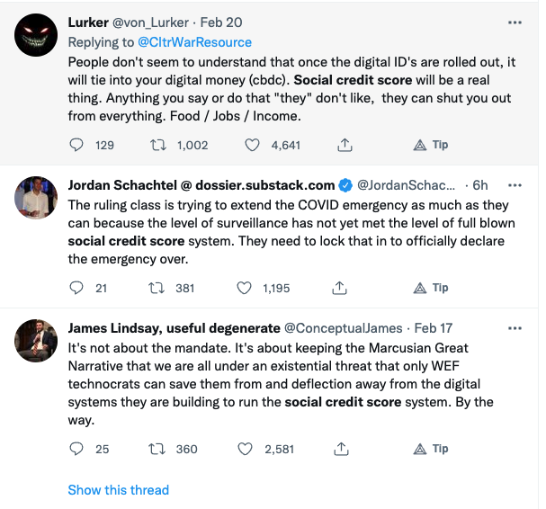
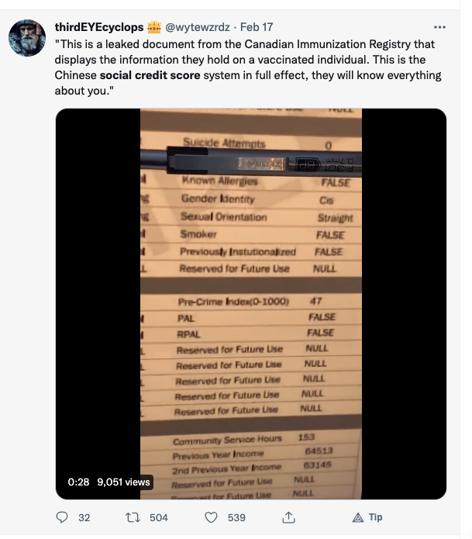

Slide 41
